Slide 1
Summary

Slide 2
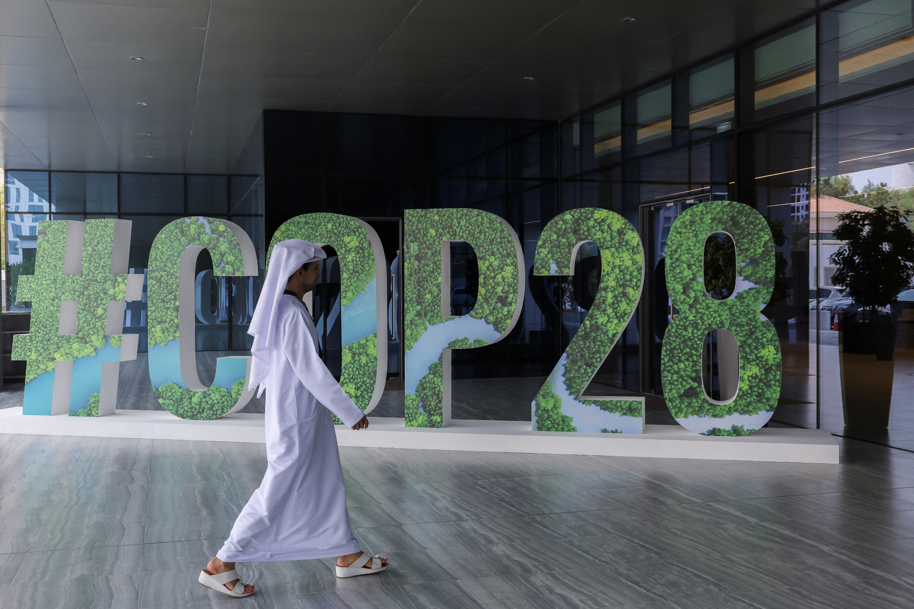
Outline
Location, Location, Location!
Global Collaboration
Fossil Fuel Decision
Global Renewable Energy Pledge
Green Shipping Corridors
Linking Climate Action and Nature
Transforming Food Systems
Global Stocktake
Loss and Damage Fund
Methane Reduction Pledge
Nuclear Energy Declaration
Notes:
Introduction of topics we are going to talk about, can finish when all the slides are completed

Slide 3
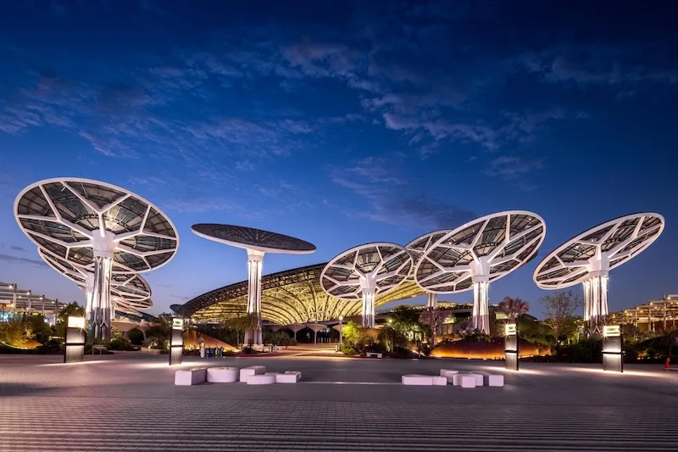
LOCATION, LOCATION, LOCATION
Was Dubai the right choose?
Predominant fossil fuel industry representing climate change
Large wealth diversion
Is Dubai even climate focused?
One of the largest CO2 emitters
The venue was so expensive!
Cost 7 Billion Dollars
Now what happens with Expo City Dubai?
Notes:
Madi Hughes
I Feel like everyone has heard the saying “Location, Location, Location”- signalling the 3 most important factors of the desirability of a… location!
But how does this factor into COP 28? As more often than not, the location of this years COP venue, Dubai in The United Arab Emirates, has been brought into question. Question and concerns brought up include…
Was Dubai the right choose? (Asked because of its predominant fossil fuel industry, with 30% of its GDP coming from oil and gas)
Is Dubai even climate focused? (Ranked one of the highest emitters for CO2 emission per capita in throughout the world)
The venue was so expensive! (Yes it was, costing 7 Billion dollars, yes that a billion with a B, that could've gone into something like the loss and damage fund… UN also did not put out a full cost report (maybe some better transparency would be nice).
However… no matter your opinion on the location of COP28 I think we can all agree on one thing. It got people talking. For better or for worse, there is now a conversation between people across the world about the reality of large cities still relying on fossil fuels, saying they are going green, and hosting COP.
Now what happens with the Expo City Duabi?
Well, now you can visit, live, work, and explore the “Human-centric city of the future”. The expo center has now turned into a 15-minute city in which the goal is for people living within to have a sustainable urban life… you just need to save 4.6 million dollars to do so first.

Slide 4
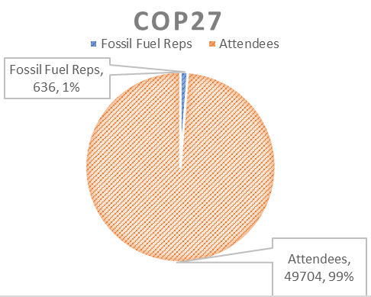
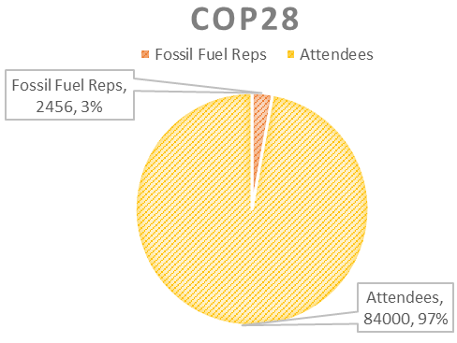
Global Collaboration
Inclusive Representation
Unprecedented attendance at COP28
Diverse stakeholders
Youth
Women
Indigenous representatives
Civil society
Various sectors of the Economy
Challenges and concerns
Notable increase in fossil fuel industry
The influence of the fossil fuel industry on climate negotiations and policy outcomes
Notes:
Balancing perspectives
Diverse perspectives
Balance between inclusivity and ensuring that the fossil fuel industry does not compromise the primary goal

Slide 5
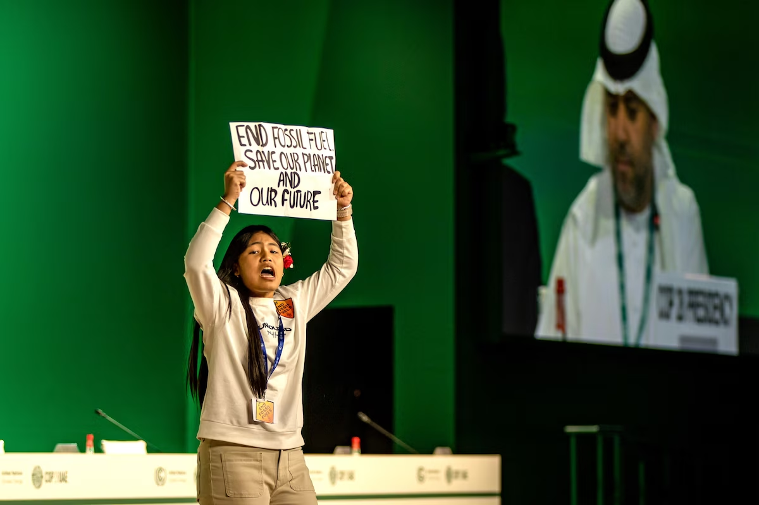
The issue with fossil fuels.
Notes:
Alexis

Slide 6
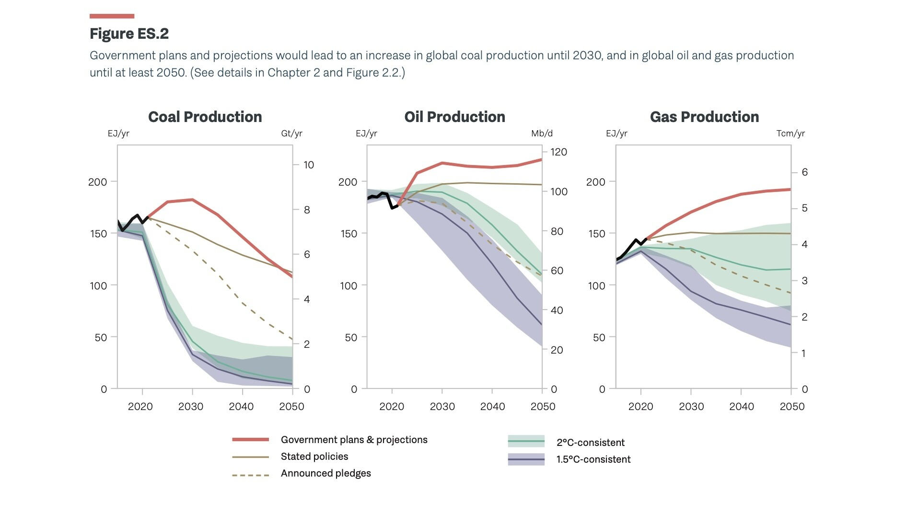
Transitioning away from fossil fuels…
Past COP meeting discussions on fossil fuels
What actions need to be taken?
Is “transition” the correct word to use?
Figure provided by World Economic Forum 2023
Notes:
As Alexis discussed, COP28 was historical compared to other meetings in the past.
COP26 was the first meeting to really acknowledge in the decision text that fossil fuels are contributing to climate change. The only outcome from meeting was a “phasedown of unabated coal power”
At COP27, there was discussion on phasing down fossil fuels, but any kind of deals were quickly shut down by oil and gas-producing countries. The main outcome from this meeting was advocation for more carbon capture technology.
So it is pretty remarkable that almost 200 countries at COP28 committed to “transitioning away from fossil fuels” but some argue this still isn’t enough.
But it is important to think about what “transitioning” means: At COP28 they mainly discussed
-tripling renewable energy capacity globally by 2030
-speeding up efforts to reduce coal use
-accelerating technologies such as carbon capture and storage
There is also a lot of controversy about the word “transition”
Transitions take time and we really can’t just unplug the current energy system we are using without building up a new energy system.
But some say there is no determined end point to a “transition”, and this term is catering countries that are still heavily reliant on fossil fuels.
Some argue that many countries have already been working towards transitioning away from fossil fuels for decades.
Maybe stronger wording such as “phase out” or “phase down” would be more applicable.
I also wanted to note that COP places no legal obligation on its signatories to meet the terms of agreements, so some say the process is a bit meaningless with a lack of accountability and enforcement.
Countries are expected to update their own climate change legislation and nationally determined contributions (NDC’s)
I just wanted to end off on this graph: The United Nations Environmental programme gap report of 2023 is projecting that fossil fuel production will keep rising for years, so there question was: will just a transition be fast enough?

Slide 7
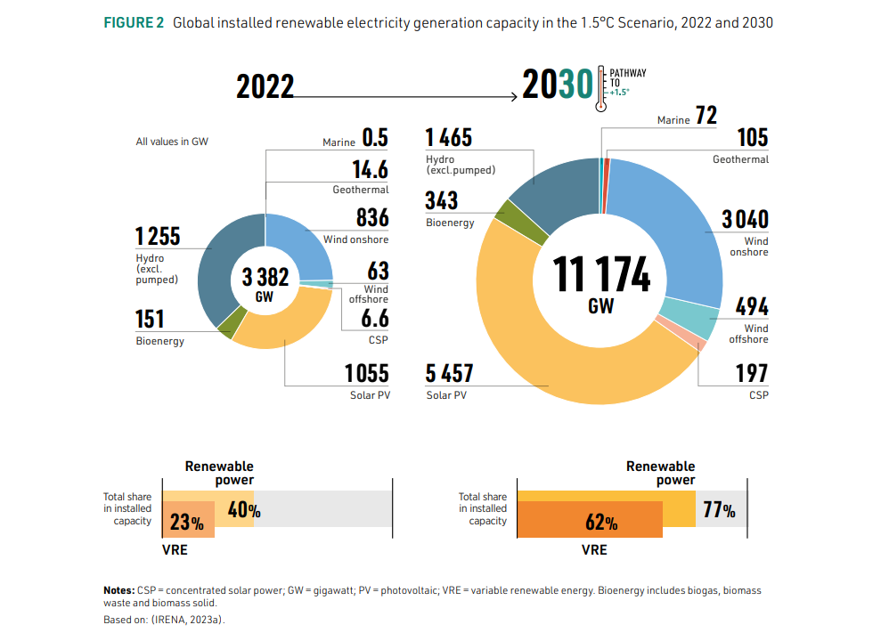
Global Renewables and Energy Efficiency Pledge
The Goal
Tripled renewable energy capacity by 2030
Doubled energy efficiency improvements
Pitfalls
Large-scale collaboration
Funding for research and support
Significant changes to policy and prioritizing investments
Notes:
The Global Renewables and Energy Efficiency Pledge was signed by 118 countries, including C
anada. By signing this pledge, these countries have committed to collectively working to triple global renewable energy capacity from just over 3,000 GW to 11,000 GW annually. Signees of this pledge also commit to collaboratively doubling the current global average rate of energy efficiency improvements from 2% to 4%. To accomplish this, these countries have committed to making energy efficiency a first priority for policy-making, planning, and major investment decisions.
Canada’s commitment to this pledge, however, is somewhat murky. Significant policy changes and shifting of priorities are needed for this goal to be achieved, but the Canadian government does have a history of not meeting targets like this. In 2021, Canada committed to reducing greenhouse gas emissions to 40-45% below 2005 levels by 2030, and are not currently on track for that goal. Additionally, a 2023 Production Gap Report shows that Canada’s oil production is set to increase through 2030. To meet these commitments, Canada need to put significant funding into technological advances in renewable energy, not increase oil production. However, responses to these commitments require nationwide cooperation, and it is difficult to ge the provinces working collectively on targets such as these.
On a global scale, potential pitfalls to the meeting of this 2030 renewables and energy efficiency goal are similar to those faced in Canada. The successful meeting of this target requires collaboration between numerous nations, many of which likely have competing interests. Collaboration on this scale takes time we simply may not have. Furthermore, success relies on substantial policy changes and funding for advancing technologies and assisting developing nations though this transition. In post-2030, projections indicate that we will have the advancements in technology necessary to make this a reality, but these advancements rely on funding and research support that does not currently exist (at least not on the necessary scale). Finally, nations may need to rely on transitional fuels, such as liquified petroleum gas (which is climate-damaging), to bridge the gap between fossil fuels and renewable energy.
https://www.pembina.org/blog/canada-needs-commit-ambitious-climate-action-cop28
COP28: Global Renewables And Energy Efficiency Pledge

Slide 8
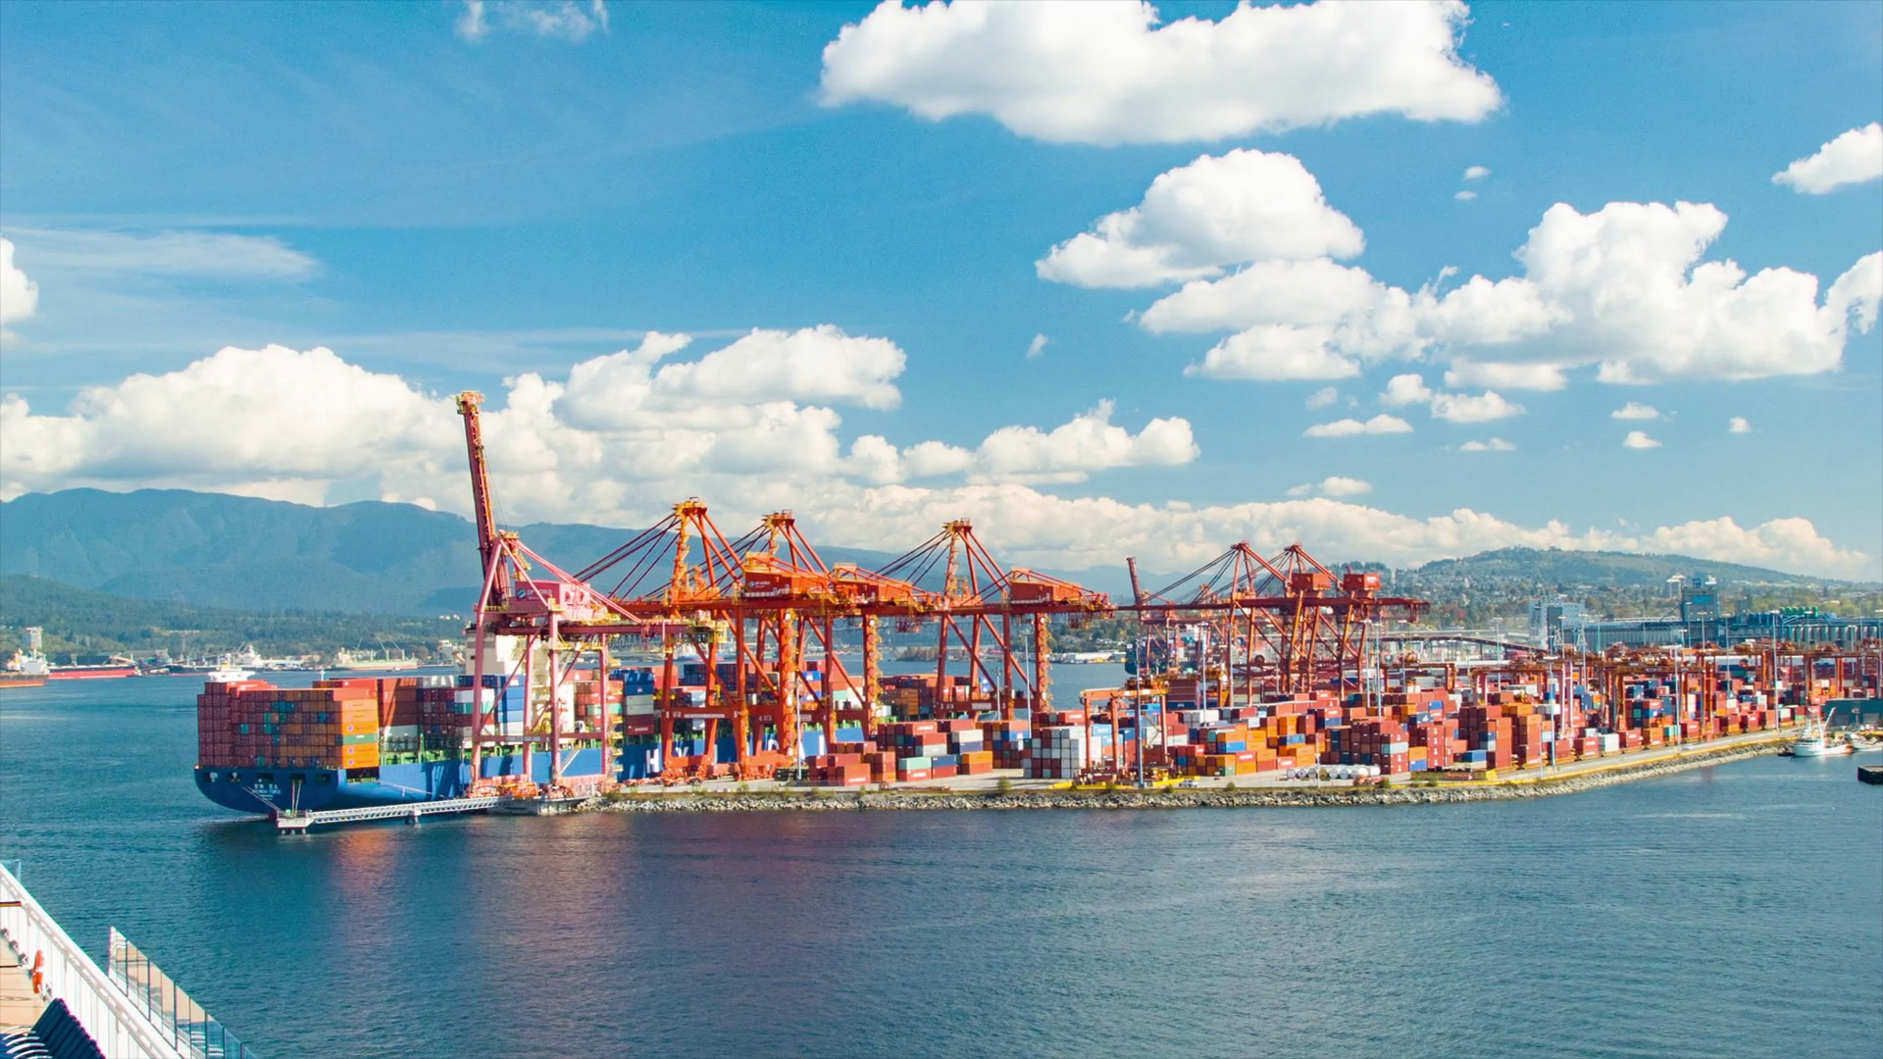
Establishing Green Shipping Corridors
Canada, in collaboration with members from the Canadian First Nations Climate Initiative (FNCI), signed a Memorandum of Understanding with the United Arab Emirates, Japan, and Korea to establish a green shipping corridor connecting Canada's West Coast to Asia and the United Arab Emirates.
Transport Canada has already committed over 165 million dollars to the initiative which will utilize state-of-the-art sprinter ships that are smaller, faster and could use green fuels such as hydrogen. The corridor will also be used to distribute clean fuels like ammonia, hydrogen, or methanol all of which will be produced in Canada.
Potential Benefits:
This green corridor would represent the shortest shipping route between North America and Asia.
Although the declaration is not legally binding, it’s encouraging that members of the FNCI were not only included in the discussions, but also endorsed the initiative, stating that they would like Canada’s First Nations to be leaders and pioneers in the decarbonization of the global shipping industry.
The International maritime transportation industry accounts for 3% of all global greenhouse gas emissions & 11% of global carbon emissions. Decarbonizing this sector using green fuels and more efficient transport corridors could be a significant step in reducing global emissions.
Building shipping infrastructure and exporting green fuels could create a lot of jobs.
Potential Challenges & Risks:
Political turbulence could affect the security of global shipping lanes.
It’s expected the industry could produce 50-250% more emissions by 2050 if no action is taken.
(B.C. Now has a massive new oil spill response vessel, the K.J. Gardner).

Slide 9
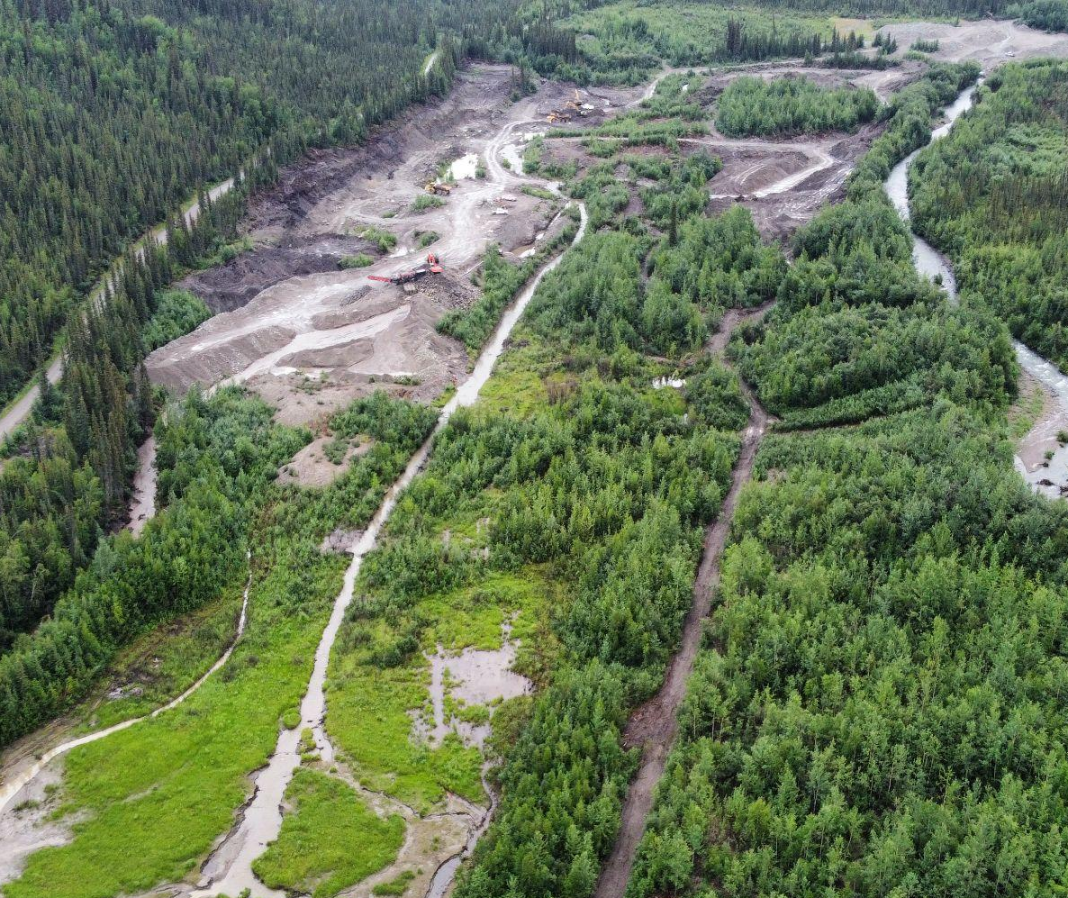
Linking climate action with nature conservation
Protecting and restoring terrestrial and marine ecosystems on every continent and ocean. One of the goals is to restore one billion hectares of degraded land by 2030. This is a very short time frame to get it done. This is important step towards meeting the temperature goal of 1.5 degrees.
Benefits of restoring ecosystems
Local climates will be more consistent and stable
Carbon sequestration will be increased
Cleaning the air and water
Wildlife biodiversity will have a better chance of recovering

Slide 10
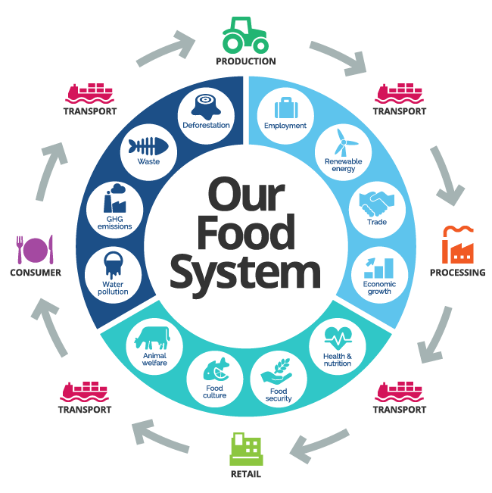
Transforming Food Systems for People, Nature and Climate
- UN Climate Change High-Level Champions collaborated with Non-State Actors (farmers, fishers, businesses, and all those in the food system) to develop a Call to Action
- Shared vision to establish food systems that deliver measurable progress for people, nature and climate
- 10 critical actions to get to the 2030 vision
- Call to Action addressed the need for time-bound holistic and global targets for COP29
Link

Slide 11
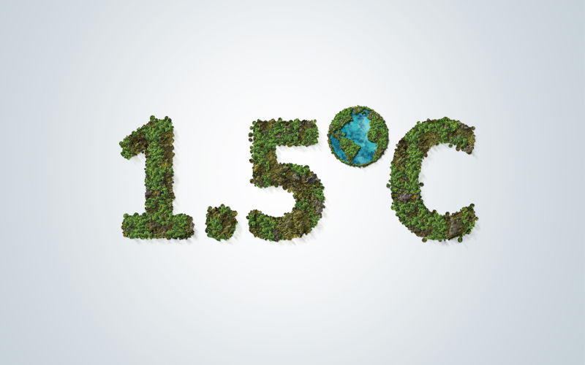
Keeping 1.5°C alive
What is the significance of the 1.5°C climate change goal?
Is this goal possible?
What changes need to be made?
Notes:
Emma

Slide 12
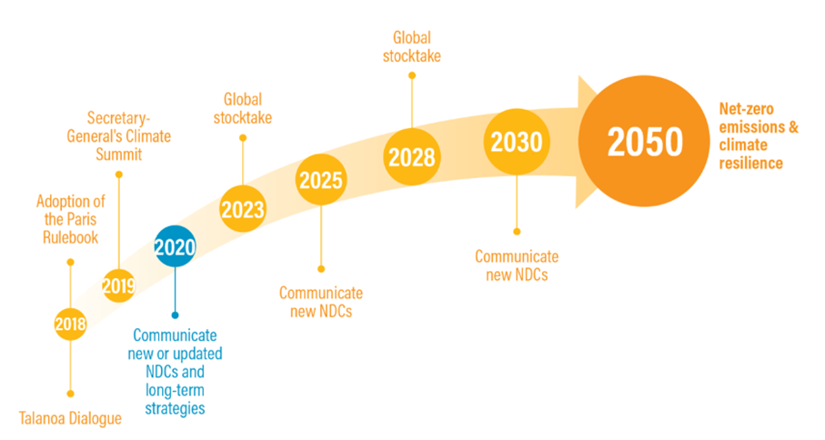
Global Stocktake and NDC
Global Stocktake and Nationally determined contributions happen every 5 years
They ensure that parties are making efforts towards reducing emissions
The Paris agreement was a legally binding international treaty
Global Stocktake is also a reminder for parties that they will have to submit their NDC soon
Notes:
Erik

Slide 13
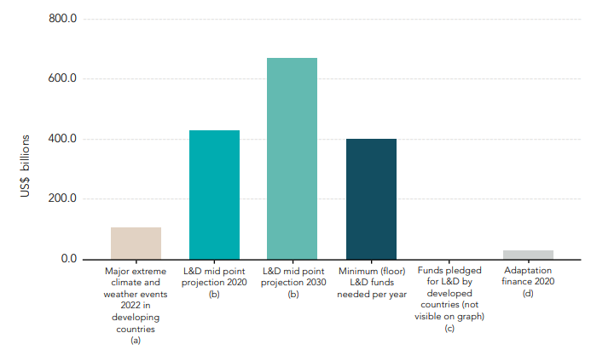
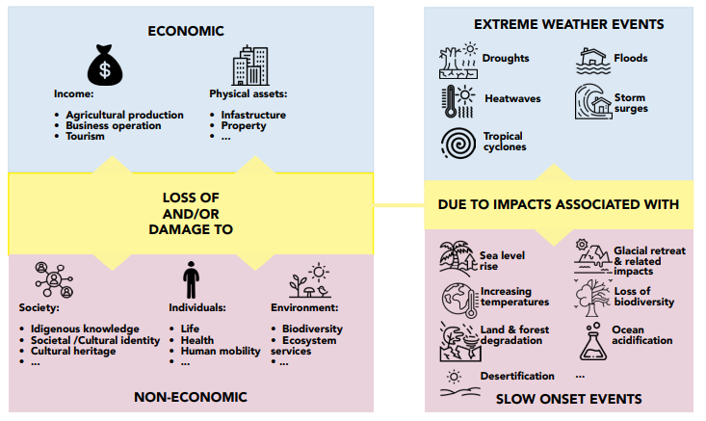
Loss and Damages Fund
Established at COP 27 as a fund to help developing nations deal with the impacts of climate change
$700M USD has been pledged at COP 28.
Administered through the World Bank
Not legally binding
Further clarification on terms and definitions needed for who is eligible and how money is distributed
Current and projected Loss & Damage (L&D) funds required. Retrieved fromhttps://assets-global.website-files.com/605869242b205050a0579e87/6462710b127e29f1b1e74ee7_The_Loss_and_Damage_Finance_Landscape_HBF_L%26DC_15052023.pdf
Economic and non-economic loss and damage from extreme or slow onset events. Retrieved from https://assets-global.website-files.com/605869242b205050a0579e87/6462710b127e29f1b1e74ee7_The_Loss_and_Damage_Finance_Landscape_HBF_L%26DC_15052023.pdf

Slide 14
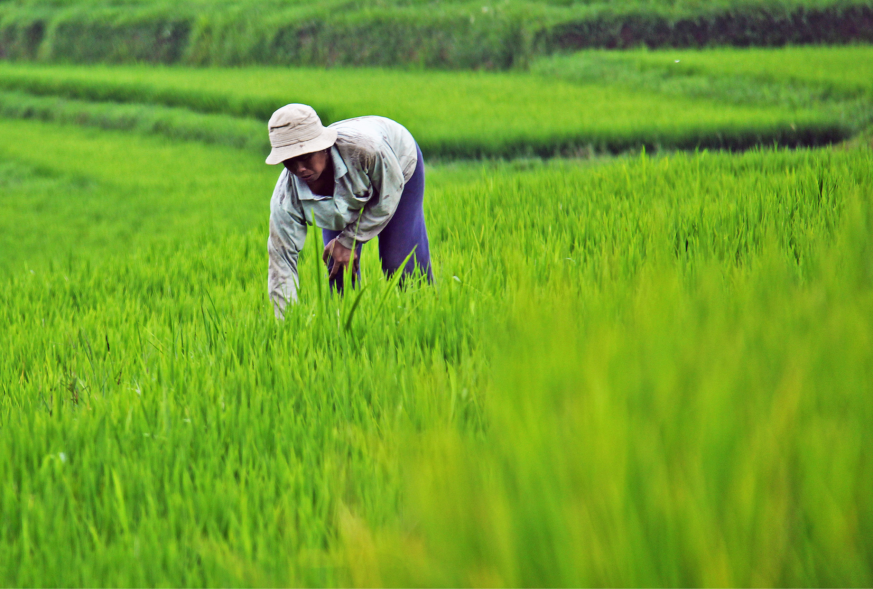
Methane Reduction Pledge
50 of the world’s largest oil and gas companies (only 40% of production) pledge to achieve near zero methane leakage by 2030
150 countries pledge 50% CH4 production by 2030.
The strategy for reduction in methane tackles rice production, livestock operations, and waste management.
Methane poses 80x the global warming threat that CO2 does
CH4 reductions will be “felt” sooner than CO2 reductions
Most methane production occurs from wetlands

Slide 15
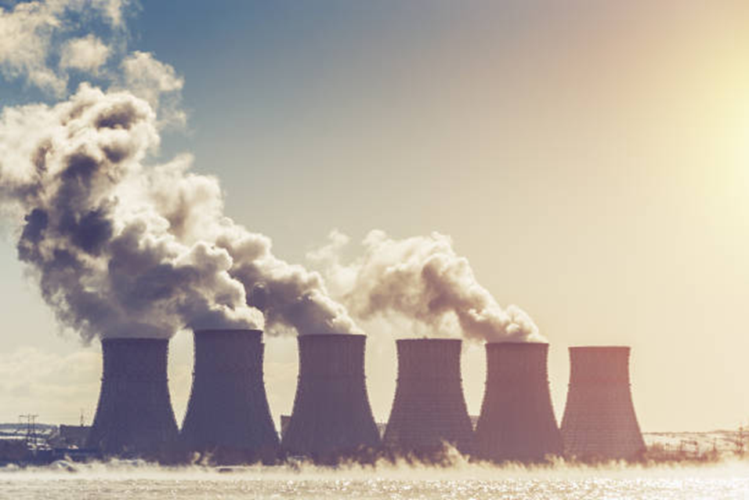
Declaration to Triple Nuclear Energy
Restrictions:
Timeline
Cost
Environmental concerns
Advantages:
Clean energy
Large output
Movement to nuclear fusion
Notes:
Ashley Sutherland:
One of the major outcomes of COP28 is the Declaration to Triple Nuclear Energy. Its goal is to triple the global capacity for nuclear energy by 2050, and encourages financial institutions to include nuclear energy in their lending policies.
Some of the restrictions to this are the timeline, the upfront cost required to build the necessary infrastructure, and the environmental concerns related to nuclear energy.
A timeline of only 26 years may not be enough to reach this goal. Currently, about 10% of the world’s electricity comes from nuclear power, so an increase to 30% is needed. To put things into perspective, in the 26 years between 1996 and 2022, the global production of nuclear energy increased from approximately 2,400 to 2,600 TWh (terawatt-hours), equivalent to an increase of only about 9%.
Although large financial institutions such as the Canada Infrastructure Bank do include nuclear energy in their lending policies, the cost to build infrastructure is significant. For example, in 2022 the CIB invested $970 million to Canada’s first Small Modular Reactor (SMR). However, the 2023 federal budget did include $20 billion to the CIB, which will likely fund similar projects.
The environmental impacts of mining for uranium, the fuel for nuclear fission, are similar to other types of metal mining. They include habitat disturbance, and risk of air or water pollution. Power generation also produces radioactive waste, which needs to be treated and stored in specialized facilities to avoid environmental contamination.
Despite restrictions, there are advantages to the Declaration. Nuclear energy is an alternative to fossil fuels that doesn’t produce greenhouse gases. It’s also capable of providing a large amount of reliable, stable power to the electrical grid to meet our current and growing energy demands. Most importantly, support for nuclear energy accelerates technological advancements towards nuclear fusion, a more viable option than fission. Neither greenhouse gases or radioactive waste are produced by fusion. Its fuel consists of hydrogen isotopes that are either readily found in the ocean, or are capable of being synthesized. Fusion is also more efficient, producing 4 times more energy than nuclear fission.

Slide 16
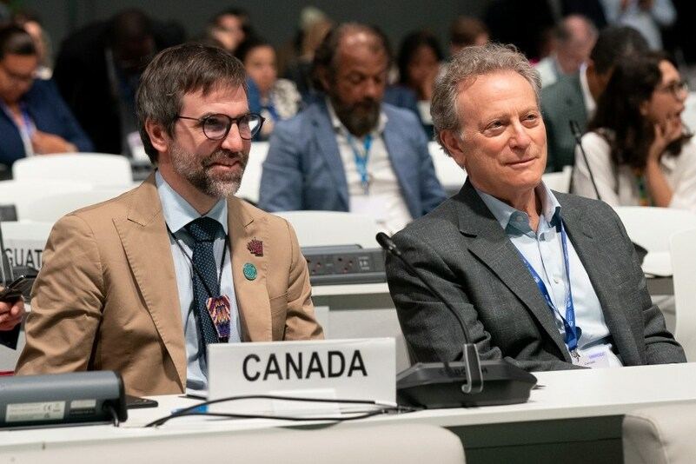
Conclusion

Slide 17
References
[CBC] Canadian Broadcast Corporation. 2023. U.A.E. pushes its ‘green’ ambition as COP 28 gets underway in Dubai. Canada: CBC https://www.cbc.ca/news/climate/uae-cop28-green-energy-transition-1.7043613#:~:text=%22Other%20than%20that%2C%20the%20economy,the%20highest%20in%20the%20world.
Expo City Dubai. 2020. Expo City Dubai. United Arab Emirates: Expo City Dubai. https://www.expocitydubai.com/en/
Food Systems Thinking.3Keel LLp. [accessed Feb 4, 2024] https://www.food.systems/
National Geographic. 2023. Fossil Fuels. Nationalgeographicorg. [accessed 2024 Feb 6]. https://education.nationalgeographic.org/resource/fossil-fuels/.
Thomson E, Shine I. 2023. Phasing down, phasing out, or transitioning away: What did COP28 agree on fossil fuels.World Economic Forum. [accessed 2024 Feb 5]. https://www.weforum.org/agenda/2023/11/phase-down-out-fossil-fuel-arguments/
Transforming Food Systems for People, Nature and Climate. 2023. Climate Champions. [accessed Feb 5, 2024] https://climatechampions.unfccc.int/wp-content/uploads/2023/11/Non-State-Actor-Call-to-Action-FINAL-VERSION-SIGNED-OFF.pdf
Transforming Our Food Systems: A call to action. Race to Resilience. [accessed Feb5, 2024] https://climatechampions.unfccc.int/system/food-systems-call-to-action/
Richards, J.-A.; Schalatek, L.; Achampong, L.; White, H. The Loss and Damage Finance Landscape; 2023. https://assets-global.website-files.com/605869242b205050a0579e87/6462710b127e29f1b1e74ee7_The_Loss_and_Damage_Finance_Landscape_HBF_L%26DC_15052023.pdf (accessed 2024-01-28).
What’s in a number, The meaning of the 1.5-C climate threshold | NOAA Climate.gov. wwwclimategov. [accessed 2024 Feb 6]. https://www.climate.gov/news-features/features/whats-number-meaning-15-c-climate-threshold#:~:text=Because%20both%20models%20and%20paleoclimate.
New Analysis of National Climate Plans: Insufficient Progress Made, COP28 Must Set Stage for Immediate Action. 2023. Unfcccint. https://unfccc.int/news/new-analysis-of-national-climate-plans-insufficient-progress-made-cop28-must-set-stage-for-immediate.
Department of Energy. 2023. https://www.energy.gov/articles/cop28-countries-launch-declaration-triple-nuclear-energy-capacity-2050-recognizing-key. [accessed 2024 Jan.27]
Countries promise clean energy boosts at COP38 to push out fossil fuels. Reuters. 2023. https://www.reuters.com/sustainability/climate-energy/over-110-countries-set-join-cop28-deal-triple-renewable-energy-2023-12-02/ [accessed 2024 Jan.27].
‌
‌

Slide 18
References
CIB. 2022. [accessed 2024 Jan. 27] https://cib-bic.ca/en/medias/articles/cib-commits-970-million-towards-canadas-first-small-modular-reactor
World Nuclear Association. 2022. [accessed 2024 Jan. 30]. https://www.world-nuclear.org/information-library/current-and-future-generation/nuclear-power-in-the-world-today.aspx
National Geographic. 2024. [accessed 2024 Jan. 27]. https://education.nationalgeographic.org/resource/nuclear-energy/

